Slide 1
Google Play Store App Rating Prediction Analysis

Slide 2
Objective
Perform Exploratory Data Analysis (EDA) on Google Play Store apps dataset using Python.
Analyze key attributes like category, genres, rating, reviews, installs, and price.
Identify patterns and trends across different types of apps and user behaviors.

Slide 3
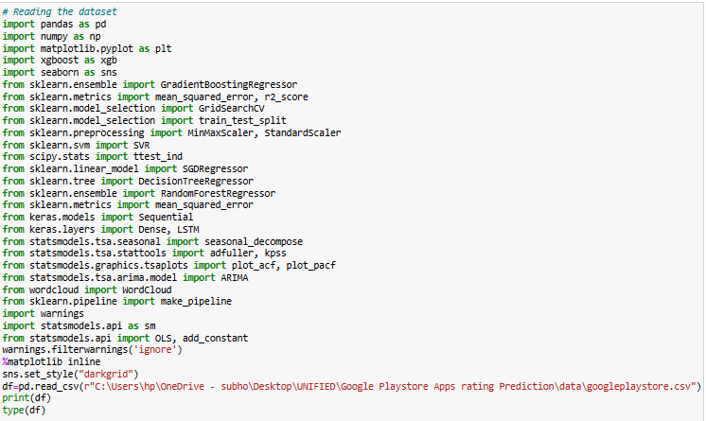
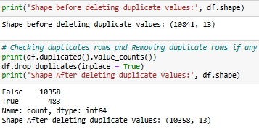
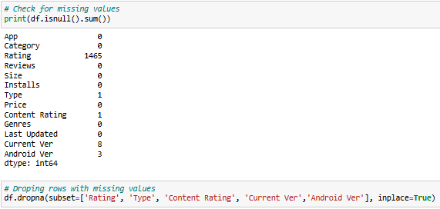
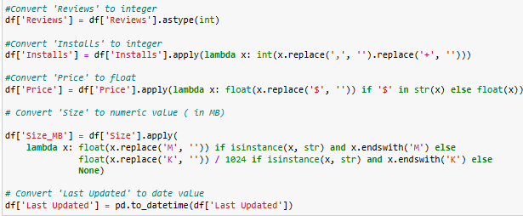
Dataset Overview
Loaded using pandas Duplicates removed
Missing values checked Convert 'Reviews' and ' Install‘ to integer

Slide 4
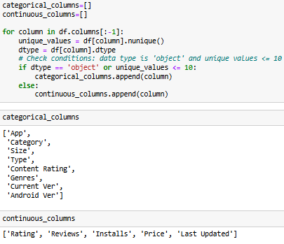
Column Classification
Categorical Columns: App, Category, Size, Type, Content Rating, Genres, Current Ver, Android Ver
Continuous Columns: date_added, release_year

Slide 5
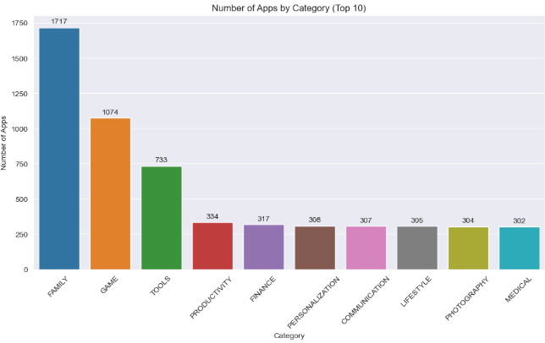
Distribution of Number of Apps by Category
Chart: Column chart showing the number of apps by category.
Observation: The Family category contains the highest number of apps (1,717), followed by Game (1,074) and Tools (733).

Slide 6
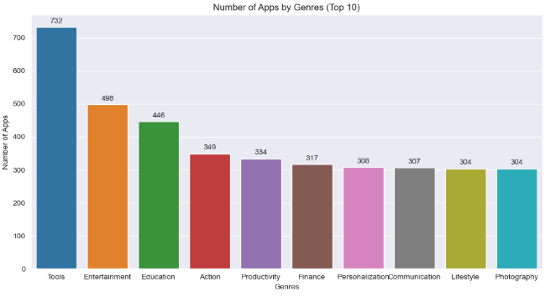
Distribution of Number of Apps by Genre
Chart: Column chart showing the number of apps by genre.
Observation: The Tools genre has the highest number of apps(732), followed by Entertainment(498) and Education(446).

Slide 7
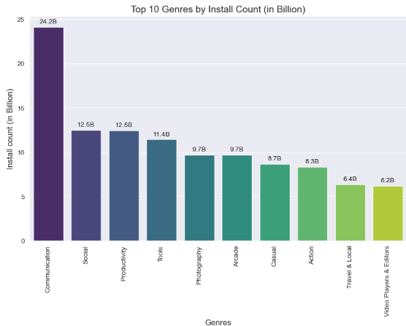
Distribution of Top Genres by Install Count
Chart: Column Chart (Install Count in Billions)
Observation: The Communication genre has the highest install count (24.2 billion), followed by Social (12.5 billion) and Productivity (12.5 billion).

Slide 8
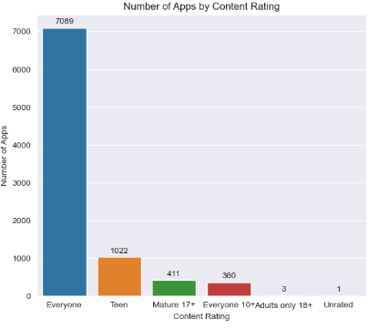
Distribution of Number of Apps by Content Rating
Chart: Column chart showing the number of apps by content rating.
Observation: The Everyone content rating has the highest number of apps (7,089), followed by Teen (1,022) and Mature 17+ (411).

Slide 9
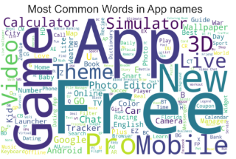
Word Cloud – App Names
Observation: Common themes in app names include words like Game, Free, App, New, Pro, and Mobile.

Slide 10
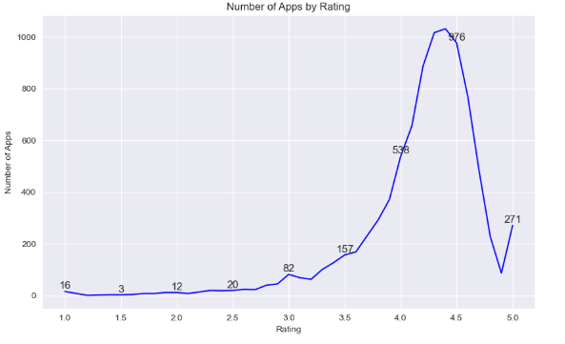
Line Chart on Number of Apps by Ratings
Chart: Line Plot – Number of Apps by Rating
Observation: From a 4 to 4.5 rating, the number of apps grows significantly. However, there is a decline in the number of apps at the 1.5 rating.

Slide 11
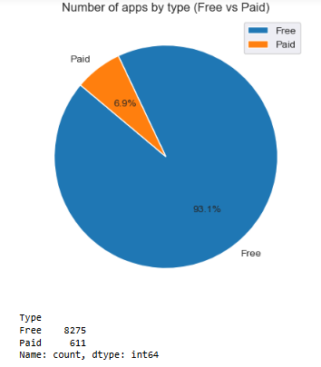
Free Apps vs. Paid Apps Distribution
Chart: Pie Chart – Number of Free Apps vs. Paid Apps
Observation: The number of free apps contributes approximately 93.1%, while paid apps contribute 6.9%.

Slide 12
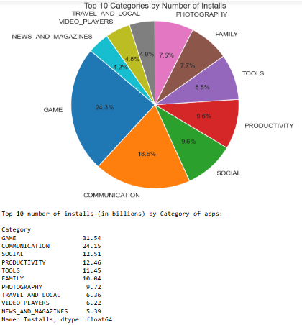
Distribution of Number of Installs by Category of Apps
Chart: Pie Chart – Number of Installs by Category of Apps (Top 10 Categories)
Observation: The Game category contributes approximately 24.3% of installs, followed by the Communication category at 18.6%, and the Social category at 9.6%.

Slide 13
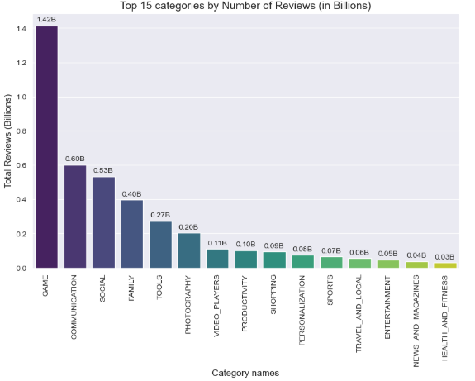
Distribution of Top 15 Categories with Most Reviews
Chart: Column Chart – Number of Reviews by Category of App
Observation: Game is the most common category (1.42 billion reviews), followed by Communication (0.6 billion) and Social (0.53 billion).

Slide 14
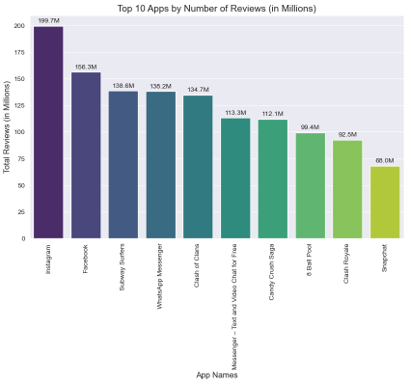
Distribution of Apps with the Most Reviews
Chart: Column Chart – Number of Reviews by App
Observation: Instagram is the most common app (199.7 million reviews), followed by Facebook (156.3 million) and Subway Surfers (138.6 million).

Slide 15
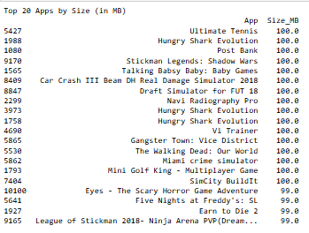
Distribution of Top 20 Apps by Individual Size
Observation: Ultimate Tennis has the largest size, followed by Hungry Shark Evolution and Post Bank.

Slide 16
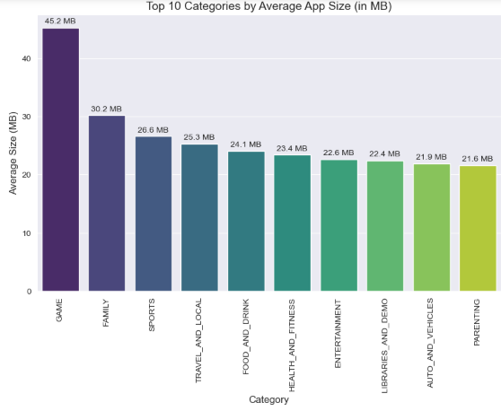
Distribution of Categories with the Largest Average Size
Chart: Column chart – Average Size by App Categories
Observation: Game is the category with the largest average size (45.2 MB), followed by Family (30.2 MB) and Sports (26.6 MB)

Slide 17
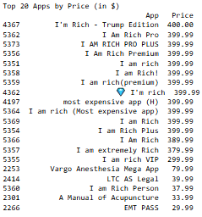
Distribution of Top 20 Apps by Individual Cost
Observation: I'm Rich - Trump Edition is the costliest app, followed by I Am Rich Pro and I AM RICH PRO PLUS.

Slide 18
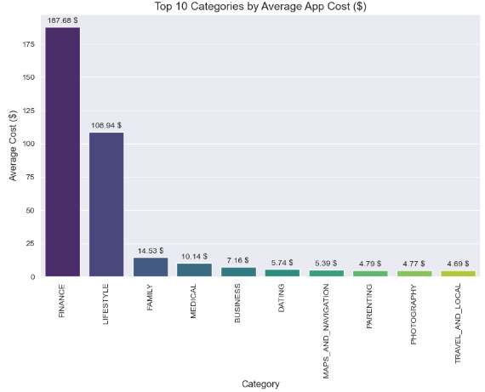
Distribution of Categories with the Largest Average Cost
Chart: Column chart – Average Cost by App Categories
Observation: Finance is the costliest category ($187.68), followed by Lifestyle ($108.94) and Family ($14.53).

Slide 19
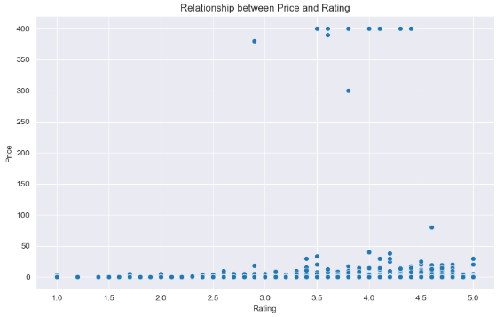
Relationship Between Price and Rating
• Chart: Scatter Plot – Price vs. Rating
• Observation: The price of apps increases significantly after a 3.5 rating.

Slide 20
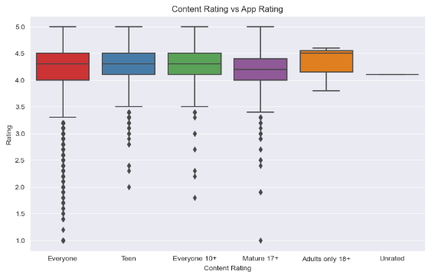
Content Rating vs. Rating
Chart: Boxplot of Content Rating
Observation: The median rating for Everyone, Teen, and Everyone 10+ is around 4.3, while the median rating for Mature 17+ is around 4.1, and the median rating for Adult 18+ is around 4.5. Among all content ratings, Everyone has the maximum number of outliers.

Slide 21
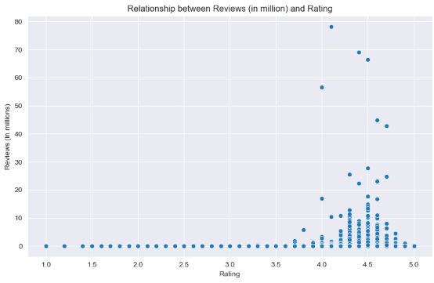
Relationship Between Number of Reviews and Rating
• Chart: Scatter Plot – Number of Reviews vs. Rating
• Observation: The number of reviews for apps increases significantly after a 4.3 rating.

Slide 22
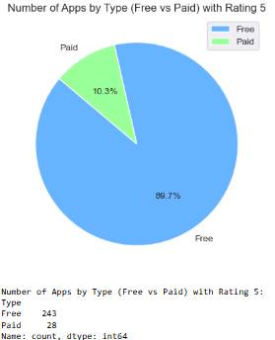
Distribution of Free and Paid Apps When App Rating is 5
Chart: Pie Chart – Number of Free Apps vs. Paid Apps When App Rating is 5
Observation: The number of free apps contributes around 89.7%, while paid apps contribute 10.3% when the app rating is 5.

Slide 23
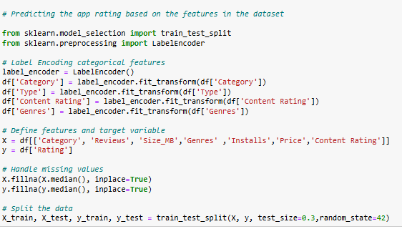
Machine learning
Feature engineering (regression model)

Slide 24






Models
REGRESSION RANDOM FOREST MODEL REGRESSION SVR MODEL
REGRESSION SGD MODEL REGRESSION MODEL DECISSION TREE
REGRESSION GRADIENT BOOSTING REGRESSOR MODEL REGRESSION xGBoost MODEL

Slide 25
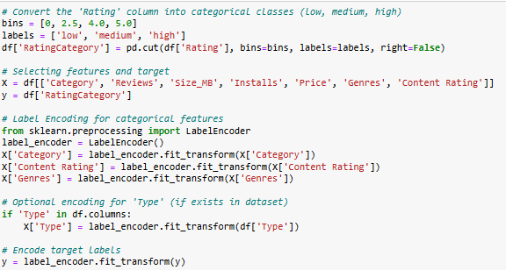
Machine learning
Feature engineering (classification model)

Slide 26
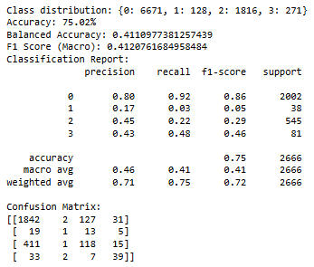
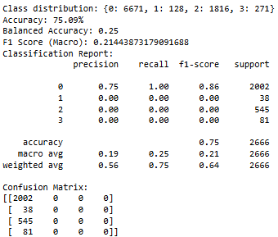
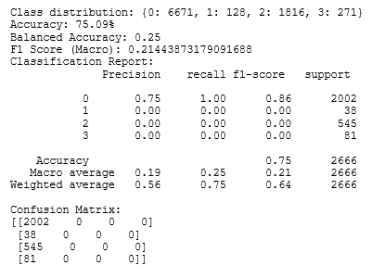
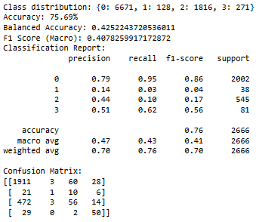
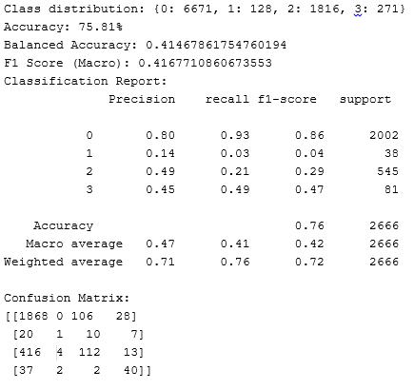
Models
CLASSIFICATION xGBoost MODEL CLASSIFICATION SVC MODEL CLASSIFICATION SGD MODEL
CLASSIFICATION GRADIENT BOOSTING MODEL CLASSIFICATION RANDOM FOREST MODEL

Slide 27
Models
Regression and classification models were applied to predict app ratings based on various features like size, installs, reviews, and price.
Regression model - The Gradient Boosting achieved the best results with the lowest RMSE (0.474) and the highest R² score (0.14), showing relatively better prediction accuracy. XGBoost followed closely with similar performance metrics. Random Forest and SVR showed moderate performance but had low R² values. Decision Tree and SGD performed poorly, especially Decision Tree with a negative R², indicating over fitting and weak predictive power overall. In overall regression models performed poorly overall, with low R² scores indicating weak predictive power.
Classification model - Among all models, Random Forest achieved the highest accuracy of 75.81% and the best macro F1-score of 0.42, showing relatively balanced performance across classes. Gradient Boosting and XGBoost followed closely with macro F1-scores around 0.41, offering better recall for minority classes. SVC and SGD models performed poorly, failing to identify any minority class (1, 2, 3), as reflected in zero F1-scores for those classes. Overall, class imbalance significantly impacted model performance, and most models favored the majority class (class 0). In overall classification models showed good overall accuracy, with Random Forest and Gradient Boosting performing best in terms of precision and F1-score.

Slide 28
Final Observations & Storyline
The Google Play Store showcases a dominant trend towards free apps, which make up around 93.1% of the total, leaving only 6.9% for paid apps. This indicates the accessibility of the platform, with most users able to enjoy apps without spending money. Additionally, the "Everyone" content rating is the most common, highlighting that a large portion of apps cater to users of all age groups, while Teen and Mature 17+ rated apps are less prevalent.
In terms of genres, Tools, Entertainment, and Education dominate the app landscape, signaling a balanced mix of utility and recreational apps. Communication apps take the lead in install counts, followed by Social and Productivity apps, reflecting the importance of staying connected and organized in today's digital world. Games stand out as the largest in average app size, while Finance and Lifestyle apps command higher prices, suggesting a shift towards premium experiences in niche categories.
Trends also show that free apps are the most prevalent among those with the highest ratings, with 89.7% of apps rated 5 stars being free. The relationship between reviews and ratings is evident, as higher-rated apps tend to gather more reviews, reinforcing the importance of user satisfaction in driving engagement. As the Google Play Store continues to evolve, free and feature-rich apps dominate, but paid apps, particularly in specific categories like Finance and Lifestyle, continue to offer premium experiences.

